Slide 1
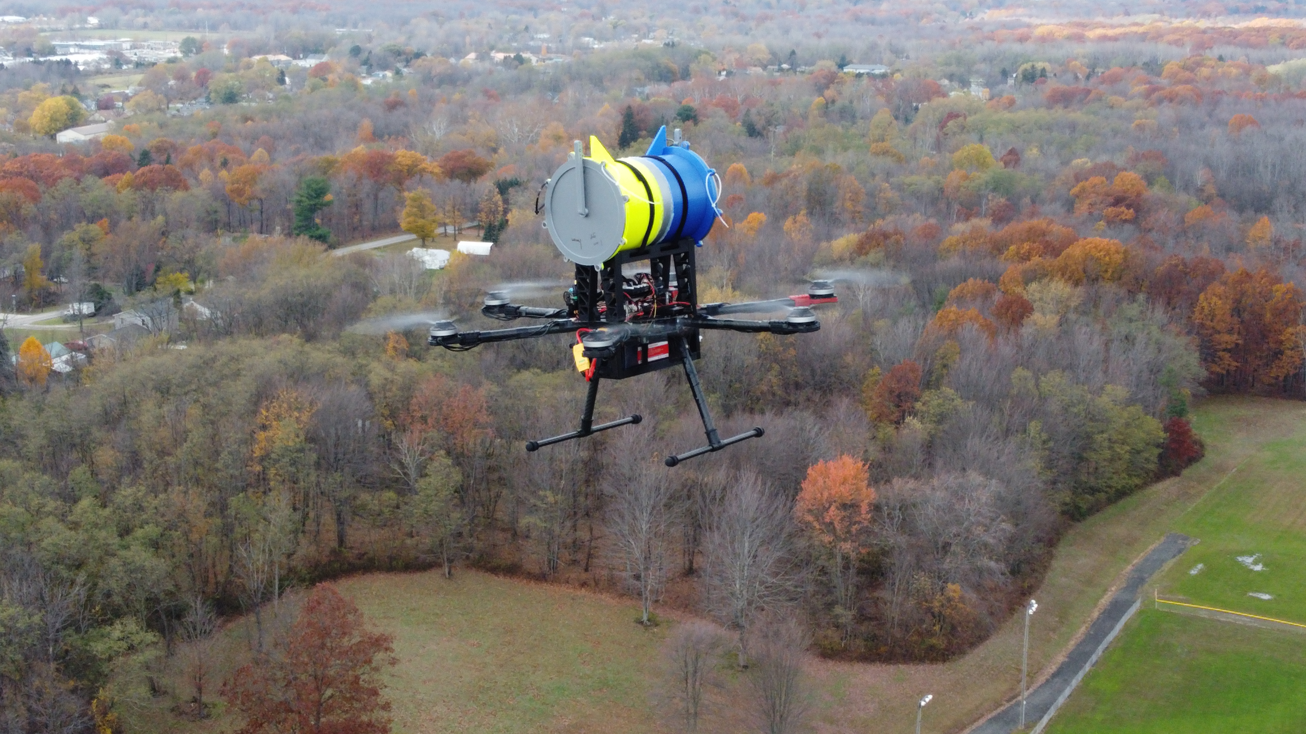
Engineering NIMBUS
Nick Devine
Design and Fabrication Engineer
Gannon Makerspace

Slide 2
Problem Statements for our Challenge
How to get sensors located at exact heights?
How to collect air from only a certain place?
How to avoid contamination?
During transport
During flight
After flight
How to test for cross contamination?
How to keep cost minimal?

Slide 3
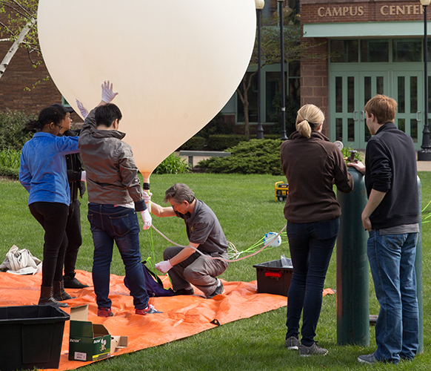
How to get sensors located at exact heights?
Multiple ideas were discussed
Weather ballons
RC Planes
Real plane/helicopter
Drone
What are some Advantages/Disadvantages?

Slide 4
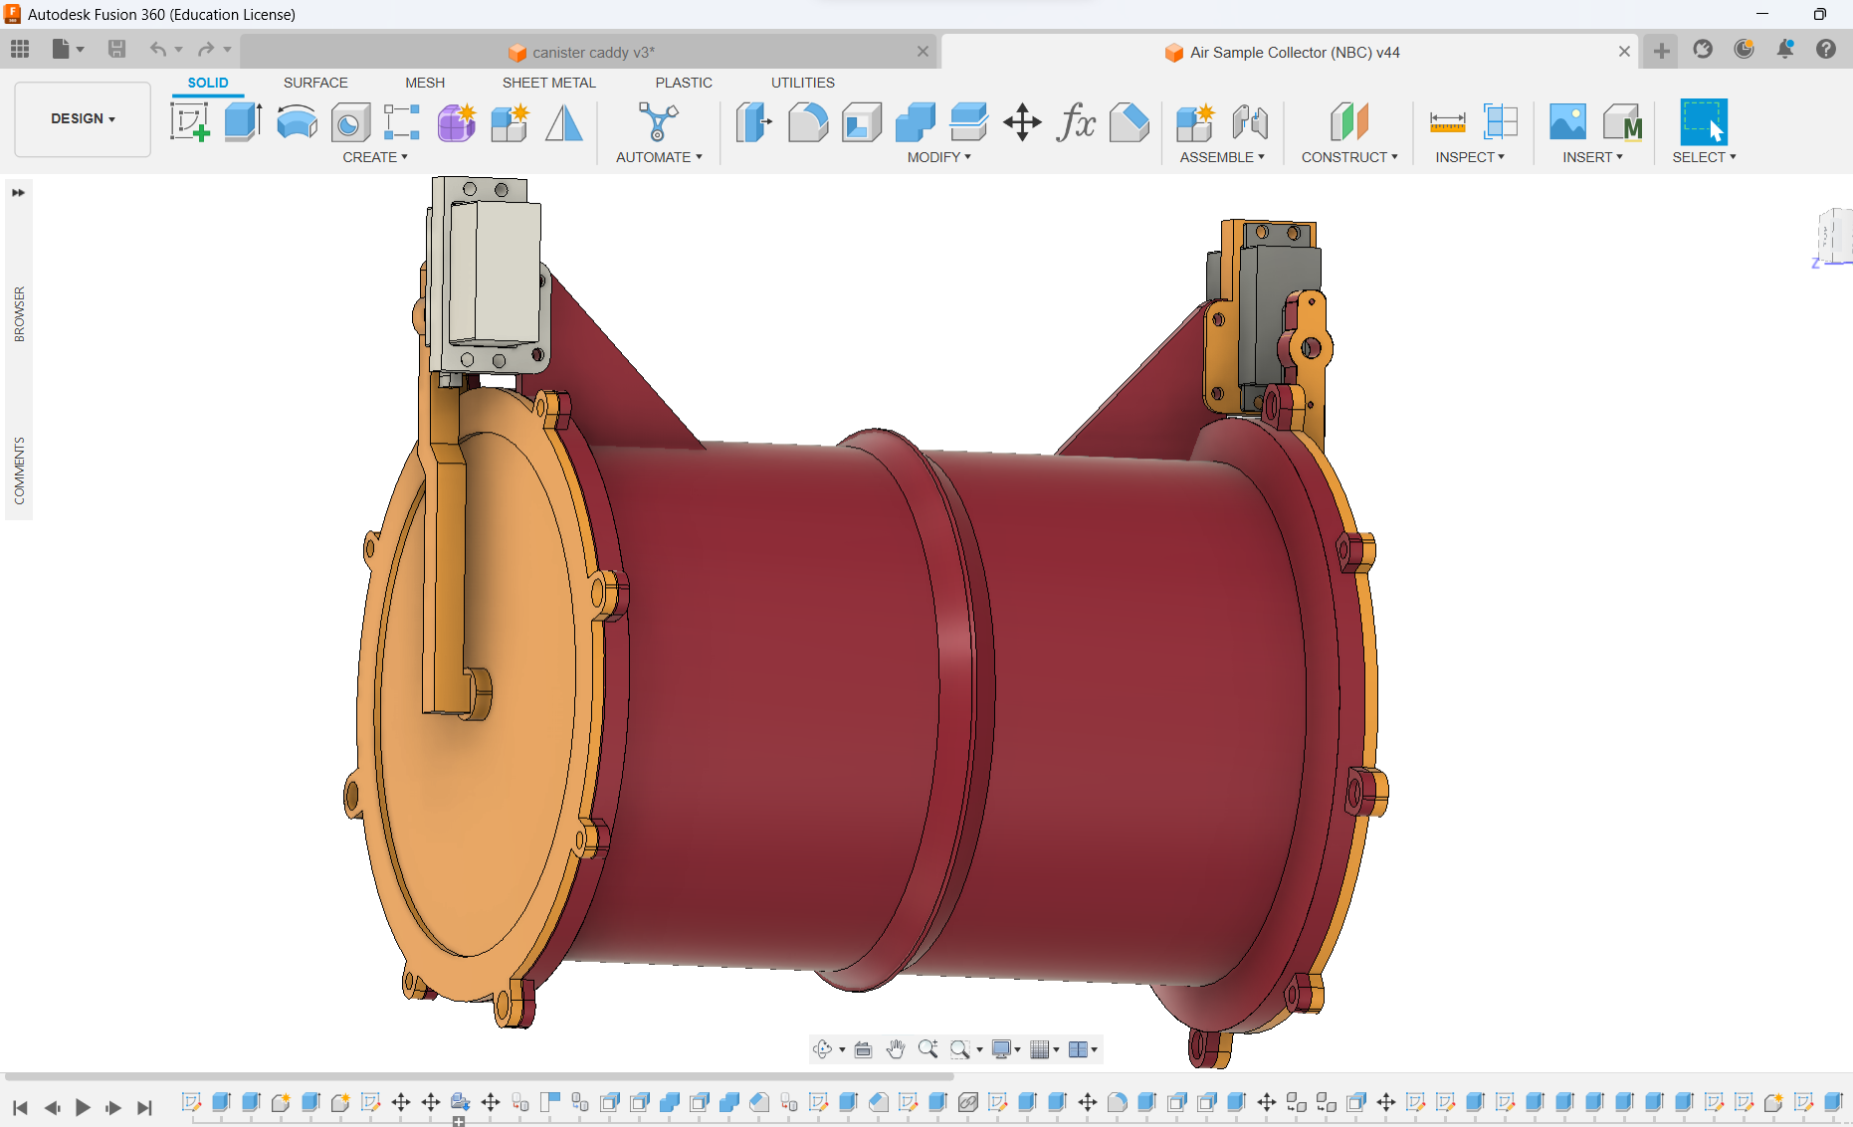
How to collect air from only a certain place and avoid contamination?
Must be a sterile environment to avoid contamination
How to make it remote controlled?
What devices need to be inside the container?
3D Printing to the Rescue!

Slide 5
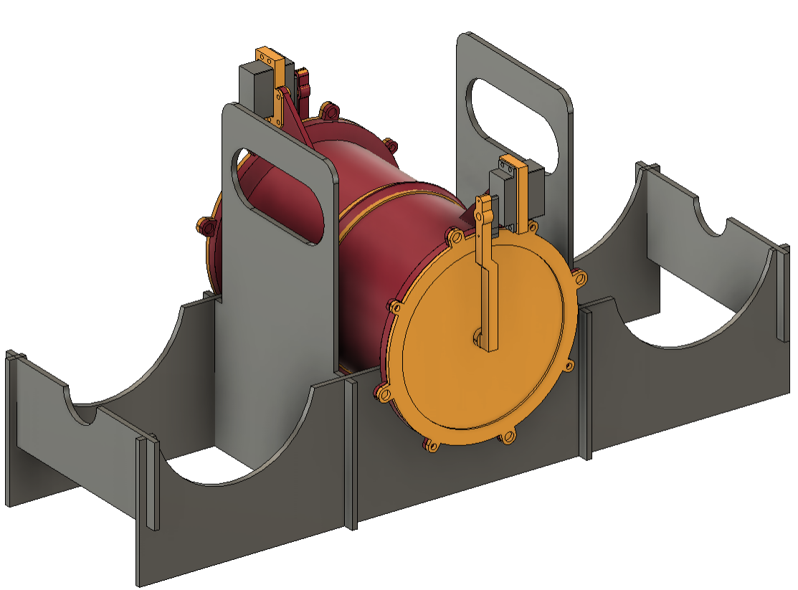
How to test results and keep cost down?
Experimental group vs Control group
How to test the control group
Cost is always a major factor in a project
Drone $2,000
Canisters ~$50
Laser cutting and 3D printing greatly reduced cost

Slide 7
Fail Early, Fail Often, but Fail Forward
John C Maxwell
With new cheaper prototyping technology such as 3D printers, the goal should be to get iterations of a solution and work towards a final outcome
DO NOT EXPECT the first to be the final
SpaceX Starship Program is a great example! Over 10 of their test ships have exploded
https://www.youtube.com/watch?v=K5Vw2ZDe-G0
Which has all led to this last launch!
https://www.youtube.com/watch?v=C3iHAgwIYtI

Slide 8
Resources to help think like an Engineer
SpaceX 5 Step Design Process
https://modelthinkers.com/mental-model/musks-5-step-design-process
Solid Edge from Siemens
https://solidedge.siemens.com/en/resource/infographic/think-like-an-engineer-poster/
STEM Smartly
https://stemsmartly.com/engineering-design-process-for-kids/

